Slide 1

Automatic Human Detection in Surveillance Camera to avoid theft activities using Artificial Intelligence
Guided by
Mrs.ChandraPraba
Project by
M. Baranitharan & R. Nagarajan

Slide 2
This project deals with the development of an application for automation of video surveillance in ATM machines and detect any type of potential criminal activities that might be arising with the automated system which would considerably decrease the inefficiency that are existing in the prevalent systems. An advanced Human detection system using Open Computer Vision technique and unsupervised Artificial Intelligence would be utilized which would create phenomenal results in the detection of the activities and their categorization. The proposed system makes efficient utilization of Open CV which has more than 2500 optimized algorithms. These algorithms can be used to detect and recognize faces, identify objects, classify human actions in videos, track camera movements, track moving objects finally ending up with the detection and identification of the necessary action for the prevention of such type of activities. The proposed system includes the specialized mechanisms for Camera Covering, Collision of human, Emergency sound detection, Long time tracking. The entire mechanism takes place in real time, decreasing the time complexity to a great extent making the system an efficient mechanism to prevent such anti-social activities.
ABSTRACT

Slide 3
REAL TIME HUMAN DETECTION AND TRACKING
Ing. Ibrahim Nahhas
Ing. Filip Orsag, Ph.D
Bruno University of Technology
Algorithms:
Highest Redundancy Ratio (HRR)
Median
Advantages:
Illumination Changes.
Position or Motion changes.
Changes in Background.
LITERATURE REVIEW-PAPER 1

Slide 4
Limitations:
Median algorithm is not flexible than HRR.
Gathered from the paper:
Human Modeling can be find by Skeletonization(Star Skeletonization).
Using tracking algorithms to estimate the position of each object, which has to achieve high precision moving object correspondence in presense of noisy foreground image, changes in size of regions occlusion and entering/existing of objects.
LITERATURE REVIEW-PAPER 2

Slide 5
HUMAN FACE DETECTION USING SKIN COLOR INFORMATION
Ing. Ibrahim Nahhas
Ing. Filip Orsag, Ph.D
Bruno University of Technology
Algorithms:
Skin color pixels
Face deteciton
Advantages:
We can find different races and different color of the people in the camera vision.
Database containing all the pixels represent human skins.
LITERATURE REVIEW-PAPER 2

Slide 6
Limitations:
Find only the faces of the human.
Gathered from the paper:
We can find the object as a Human faces or not.
Ability to recognize faces of people of various races.
The Database of all pixels of human skin will helps to find whether person or an object
This algorithm can pick only these colors to find the faces of the human.
LITERATURE REVIEW-PAPER 1

Slide 7
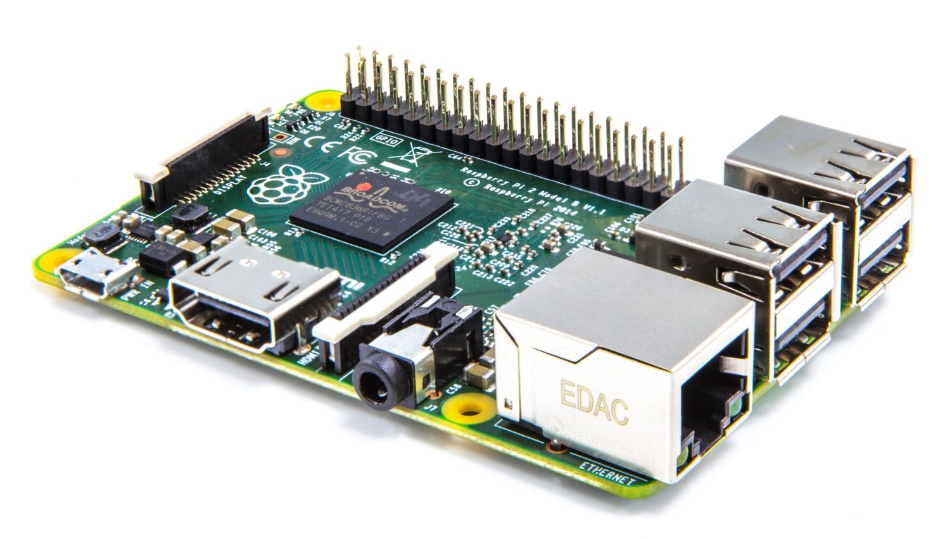
Raspberry Pi-A Credit card size CPU
SYSTEM REQUIREMENTS

Slide 8
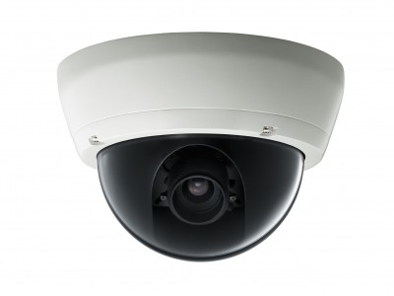
Surveillance camera- To record the environment
SYSTEM REQUIREMENTS

Slide 9

For Live Streaming, even we can use the Vision API for the human Detection
SYSTEM REQUIREMENTS

Slide 10
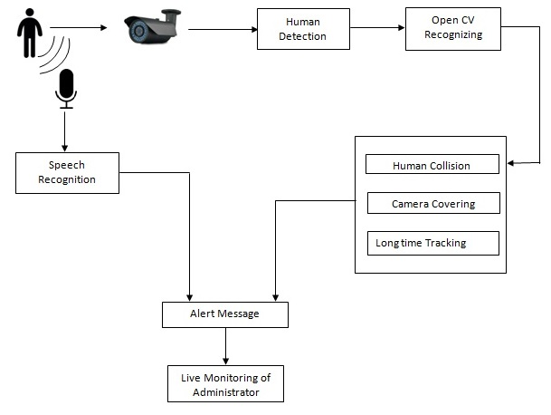
ARCHITECTURAL DIAGRAM

Slide 11
USECASE DIAGRAM

Slide 12
Human Detection
Camera Covering
Human Collision
Speech Recognition
MODULES

Slide 13

Open CV has more than 2500 optimized algorithms. These algorithms can be used to detect and recognize faces, identify objects, classify human actions in videos, track camera movements, track moving objects.
ALGORITHM

Slide 14

ALGORITHM

Slide 15
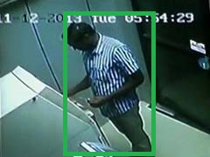
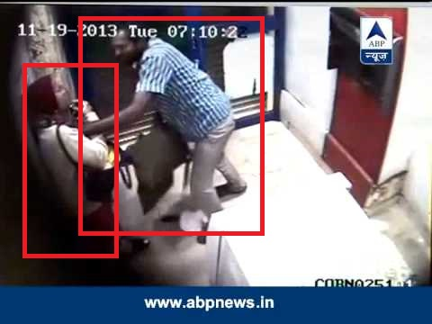
Human Detection
And
Tracking
Human Collision
EXPECTED OUTCOME

Slide 16
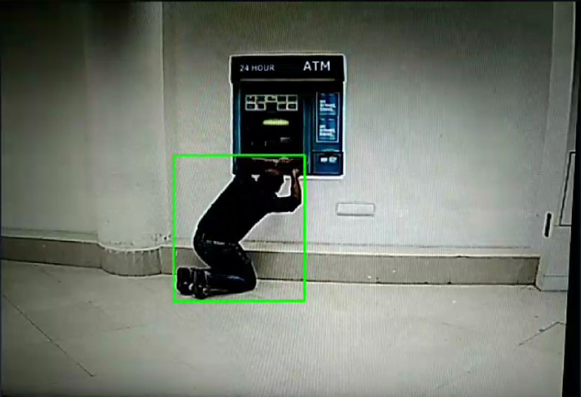

Long time Detection
Camera Closing
EXPECTED OUTCOME

Slide 17

Voice Recognition for Alert Message
EXPECTED OUTCOME

Slide 18
In this project we implements Artificial Intelligence in surveillance camera with an advanced computer vision techniques it really helps to avoid the theft activities in ATM centers before they really acquired.
CONCLUSION

